Slide 1
Topic:HTML Basics

Slide 2
HyperText Markup Language - Features
Web page is a web document that is suitable for the World Wide Web and the web browser
HTML(HyperText Markup Language) is the standard markup language used to create web pages
HTML is written in the form of HTML elements consisting of tags enclosed in angle brackets (like <html>).
HTML describes the structure of a website semantically along with cues for presentation, making it a markup language rather than a programming language

Slide 3
Main points
Markup language not equal programming language
Hypertext is text displayed on a computer display or other electronic devices with references
HTML is the standard markup language for creating Web pages
HTML describes the structure of a Web page
HTML consists of a series of elements
HTML elements tell the browser how to display the content

Slide 4
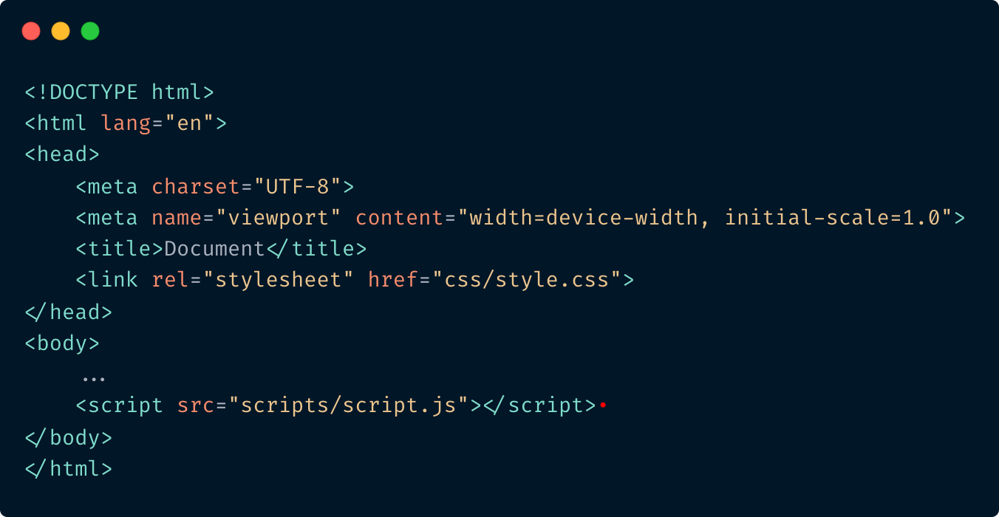
Webpage example

Slide 5
Tags
Opening and closing tags:​
<tag>Some text</tag>
Single (empty) tag:​
<tag />
Parent and child tags:​
<first-tag>
<second-tag>Some text</second-tag>
</first-tag>
Comment:
<!-- Comment content -->

Slide 6
Attributes
Example:
<tag attribute1="value" attribute2="value"> ... </tag>
Extend the capabilities of individual tags. The order of the attributes doesn’t matter.
Examples: id, class, name, title, style, src, type

Slide 7
<!DOCTYPE>
Element <!DOCTYPE> is intended to indicate the type of the document -
DTD (document type definition), for the browser to know how to parse the page.
There are several versions HTML/XHTML (eXtensible HyperText Markup Language), as well as HTML5, which diﬀer in syntax.
The <!DOCTYPE> declaration is not an HTML tag, it is an instruction to the web browser about what version of HTML the page is written in.

Slide 8
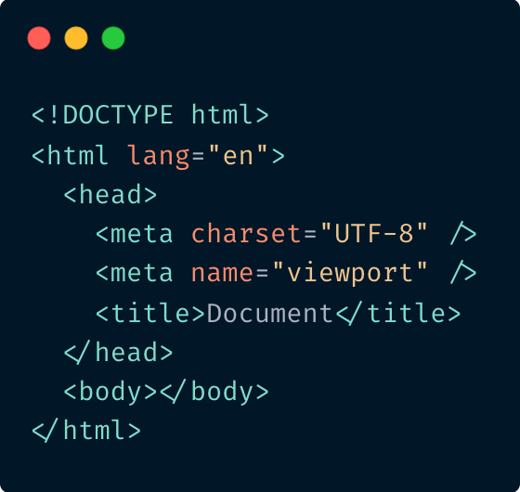
Web page structure
<html>
This is a container that includes the entire page content.
There is always two sections on the page: head and body.
<head>
Contains information about the HTML file:
the name of the page, style, meta tags and additional inform action.
<meta>
Meta tags that contain information for browsing and retrieva l systems (charset, description, keywords) for SEO, OpenGraph, etc.
<body>
Contains all the text and tags that are displayed on the page.

Slide 9
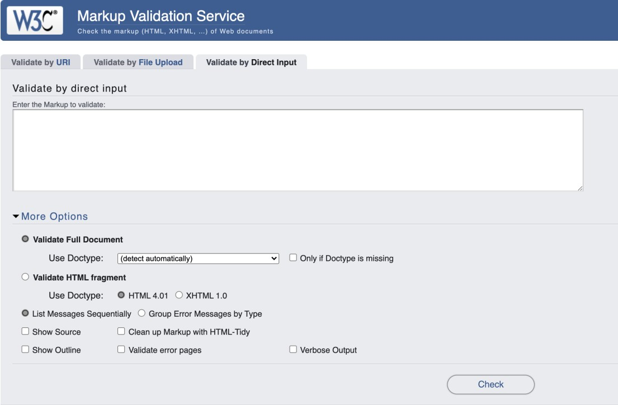
Validation
Validator checks the markup validity of Web documents in HTML validator.w3.org

Slide 10
Elements of the page
Headings:
<h1>, <h2>, <h3>, <h4>, <h5>, <h6>
Some block elements:
<p>, <pre>, <address>, <blockquote>
Some inline elements:
<sub>, <sup>, <del>, <ins>, <code>, <q>, <cite>,
<big>, <small>, <b>, <strong>, <i>, <em>, <br>, <hr>

Slide 11

Block and Inline Elements
A block-level element always starts on a new line.
A block-level element always takes up the full width available (stretches out to the left and right as far as it can).
A block level element has a top and a bottom margin, whereas an inline element does not.
An inline element does not start on a new line.
An inline element only takes up as much width as necessary.

Slide 12
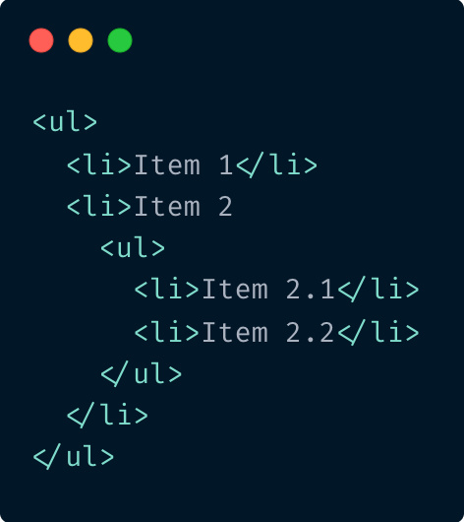
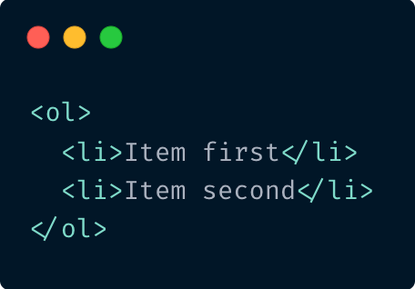
Lists
Ordered list:
Ordered list:
Demo:
Item first
Item second
Demo:
Item 1
Item 2
Item 2.1
Item 2.2

Slide 13
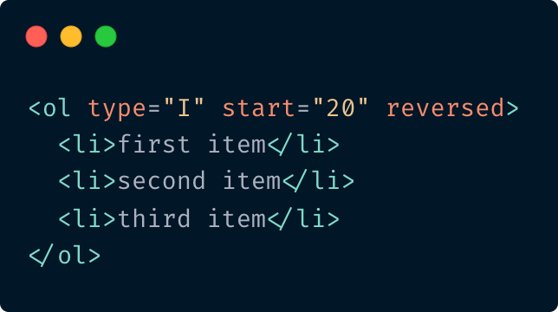
More about ordered list. Attributes
reversed - This Boolean attribute specifies that the items of the list are specified in reversed order.
start - This integer attribute specifies the start value for numbering the individual list items.
type - Indicates the numbering type.
Demo:
XX. first item
XIX. second item
XVII. third item

Slide 14
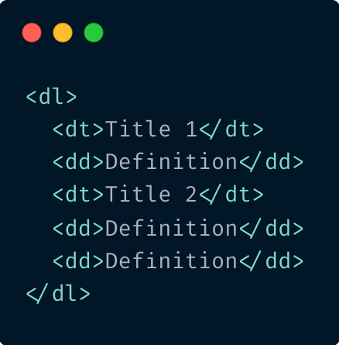
Lists. Description list
Demo:
Title1
Definition Title2
Definition
Definition

Slide 15

Elements of the page
Images
<img src="img/picture.png" alt="Alt text" />
Demo:
Go to Epam
Links
<a href="http://www.epam.com/">Go to
Epam</a>
Demo:
Image inside a link
<a href="http://www.epam.com/">
<img src="img/picture.png" />
</a>

Slide 16
More about images
inserts a graphical image into the page (inline)
the src attribute specifies the image URL
relative URL is a partial URL specified in relation to some existing URL: src="images/gollum.jpg"
absolute URL is a complete URL to a web
source: src=“http://i.imdb.com/images/nb15/logo2.gif"
HTML5 also requires an alt attribute describing the image
If the browser is unable to fetch the image, it will show the alt text​
if placed in an a anchor, the image becomes a link
title attribute is an optional tooltip (on ANY element)
Other attributes are width and height: their value can be given as pixels or percentage of window.
If not used, the image will be shown in its actual size​

Slide 17



More about tag <a>. Attributes
href elements must have a value that is a valid URL .​
target if present, must be a valid browsing context name or keyword. It gives the name of the browsing context that will be used.
type The type attribute, if present, gives the MIME type of the linked resource. The value must be a valid mime type.
download if present, indicates that the author intends the hyperlink to be used for downloading a resource​

Slide 18
More about tag <a>. Attribute “target”
T H E TA R G E T AT T R I B U T E S P E C I F I E S W H E R E TO O P E N T H E L I N K E D D O C U M E N T
_blank | Opens the linked document in a new window or tab
_self | Opens the linked document in the same frame as it was clicked (this is default)​
_parent | Opens the linked document in the parent frame
_top | Opens the linked document in the full body of the window​
framename | Opens the linked document in a named frame
<a href="https://www.example.com" target="_blank">example</a>

Slide 19
More about tag <a>. Attribute rel
Value​ | Description
alternate​ | Provides a link to an alternate representation of the document (i.e. print page, translated or mirror)​
author​ | Provides a link to the author of the document
bookmark | Permanent URL used for bookmarking​
next | Provides a link to the next document in the series​
nofollow | Links to an unendorsed document, like a paid link.​ ("nofollow" is used by Google, to specify that the Google search spider should not follow that link)​
noreferrer | Requires that the browser should not send an HTTP referer header if the user follows the hyperlink
noopener | Requires that any browsing context created by following the hyperlink must not have an opener browsing context
prev | The previous document in a selection
search | Links to a search tool for the document​
tag​ | A tag (keyword) for the current document​
Specifies the Relationship Between the Current Document and the Linked Document

Slide 20
Uniform Resource Locator (URL)
R E L AT IV E PAT H S
Index.html
/graphics/image.png
/help/articles/how-do-i-set-up-a- webpage.html
A B S O LU T E PAT H S
http://www.mysite.com
http://www.mysite.com/graphics/image.png
http://www.mysite.com/help/articles/how-do- i-set-up-a-webpage.html

Slide 21
Anchor
A hash mark (#), specifies an internal target location (an ID of an HTML element) within the current document. URLs are not restricted to Web (HTTP)-based documents, but can use any protocol supported by the browser.
<h1 id=”top”>Top</h1>
<a href="#top">go to top</a>

Slide 22
Phone link, Email link, Skype link
<a href="tel:+04951234567">+0 (495) 123-45-67</a>
<a href="mailto:example@mail.com">example@mail.com</a>
<a href="skype:someskype?call">someskype</a>
See more at Web based protocol handlers.

Slide 23
Details about the tag <img>
< IM G > R E P R ES E N TS A N I M AG E I N T H E D O C UM E N T .​
Mainstream image formats are WebP, JPEG, PNG, GIF
src: specifies the path to the image
alt: specifies an alternate text for the image, if the image for some reason cannot be displayed
<img src="epam-logo.png" alt="EPAM logo" width="500" height="600">
https://developer.mozilla.org/en -US/docs/Web/Media/Formats/Image_types

Slide 24
Tables
<table>
It is used as a container for elements that define the contents of the table.
Each table row is defined with the <tr> tag. A table header is defined with the <th> tag.
By default, table headings are bold and centered. A table data/cell is defined with the <td> tag.
colspan attribute is used to combine neighboring columns in the table
rowspan - to combine rows
Inside <table> you can use only the following elements:
<caption>, <col>, <colgroup>, <tbody>, <td>, <tfoot>, <th>, <thead> and <tr>
For common column styles we can specify the information once, on a <col> element.
<col> elements are specified inside a <colgroup> container just below the opening <table> tag.

Slide 25
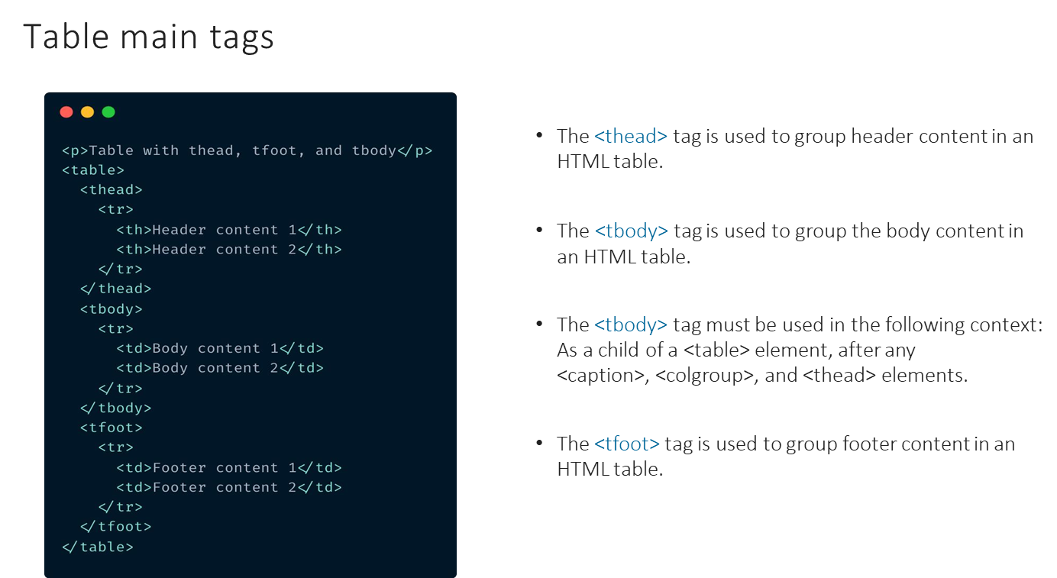

Slide 26
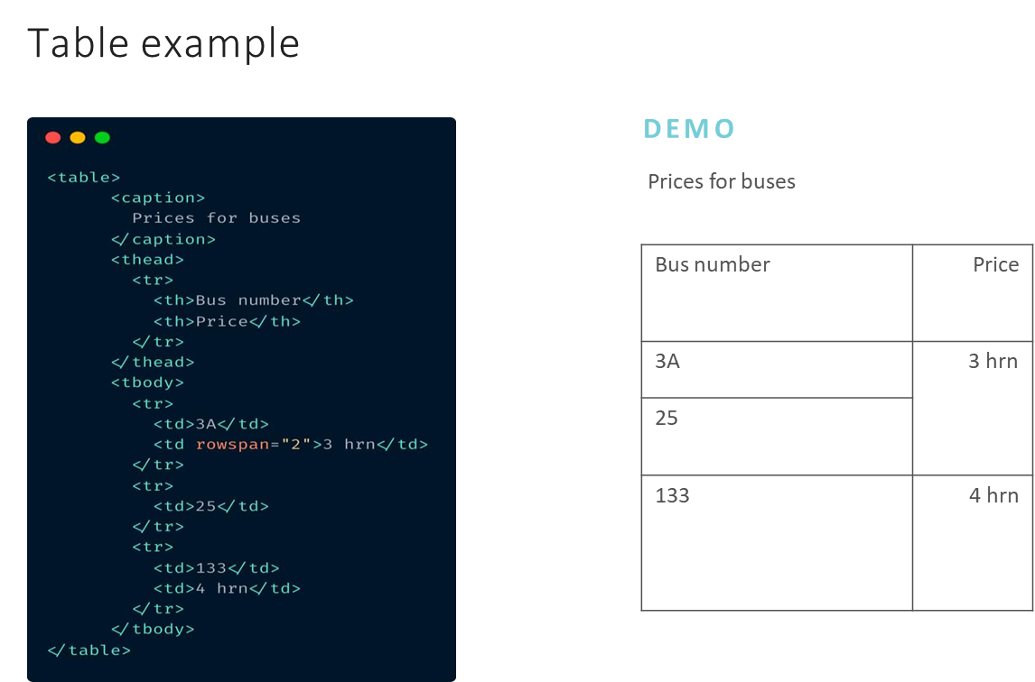

Slide 27
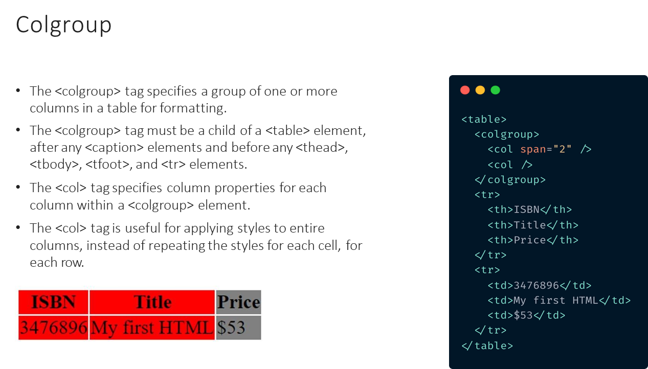

Slide 28
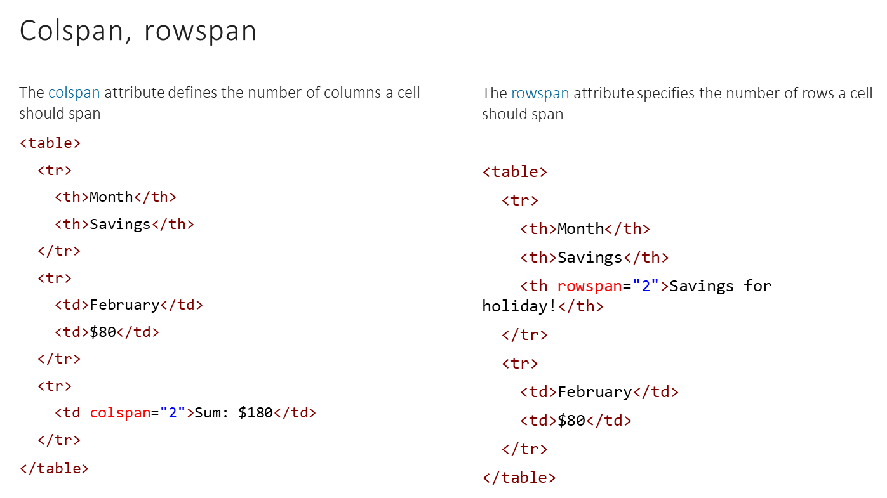

Slide 29
Elements with no semantic meaning
Div is a block-level element that creates a line break to make separate containers or boxes within a page or document, hence it is an abbreviation for 'division', whereas span is a generic container for inline elements and content that allow us to apply styles and other attributes to the content within the span element.
<div> - block element
<span> - inline element

Slide 30
Additional links
https://validator.w3.org/
https://developer.mozilla.org/
https://caniuse.com/
https://github.com/htmllint/htmllint/wiki/Options

